Slide 1
CHAPTER 19:
Decision Theory
to accompany
Introduction to Business Statistics
seventh edition, by Ronald M. Weiers
Presentation by Priscilla Chaffe-Stengel
Donald N. Stengel
© 2011 Cengage Learning.
All Rights Reserved. May not be scanned, copied, or duplicated, or posted to a publicly accessible website, in whole or in part.

Slide 2
Chapter 19 - Learning Objectives
Express a decision situation in terms of decision alternatives, states of nature, and payoffs.
Differentiate between non-Bayesian and Bayesian decision criteria.
Determine the expected payoff for a decision alternative.
Calculate and interpret the expected value of perfect information.
Express and analyze the decision situation in terms of opportunity loss and expected opportunity loss.
Apply incremental analysis to inventory-level decisions.
© 2011 Cengage Learning.
All Rights Reserved. May not be scanned, copied, or duplicated, or posted to a publicly accessible website, in whole or in part.

Slide 3
Chapter 19 - Key Terms
Levels of doubt
  Risk
  Uncertainty
  Ignorance
Decision situation
  Decision alternatives
  States of nature
  Probabilities
  Expected payoff
Maximin criteria
Maximax criteria
Minimax regret
Expected value of perfect information
Expected opportunity loss
Incremental analysis
© 2011 Cengage Learning.
All Rights Reserved. May not be scanned, copied, or duplicated, or posted to a publicly accessible website, in whole or in part.

Slide 4
The Decision Situation
The decision maker can control which decision alternative (row) is selected but cannot determine which state of nature (column) will occur.
The decision alternative is selected prior to knowing the state of nature.
© 2011 Cengage Learning.
All Rights Reserved. May not be scanned, copied, or duplicated, or posted to a publicly accessible website, in whole or in part.

Slide 5
An Example, Problem 19.38
Problem 19.38: A ski resort operator must decide before the winter season whether he will lease a snow-making machine. If he has no machine, he will make $20,000 if the winter is mild, $30,000 if it is typical, and $50,000 if the winter is severe. If he decides to lease the machine, his profits for these conditions will be $30,000, $35,000, and $40,000, respectively. The probability of a mild winter is 0.3, with a 0.5 chance of a typical winter and a 0.2 chance of a severe winter. If the operater wants to maximize his expected profit, should he lease the machine? What is the most he should be willing to pay for a perfect forecast?
© 2011 Cengage Learning.
All Rights Reserved. May not be scanned, copied, or duplicated, or posted to a publicly accessible website, in whole or in part.

Slide 6
The Decision Situation:
Problem 19.38
The decision alternatives are:
  The operator does not lease the snow-making machine.
  The operator does lease the snow-making machine.
The states of nature are:
  The winter is mild.
  The winter is typical.
  The winter is severe.
© 2011 Cengage Learning.
All Rights Reserved. May not be scanned, copied, or duplicated, or posted to a publicly accessible website, in whole or in part.

Slide 7
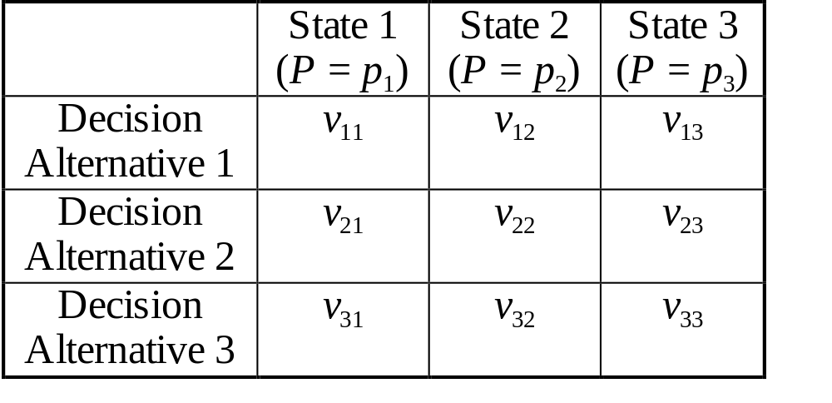
The Payoff Table
where v_{ij} is the payoff value associated with the selecting Alternative i and having State j occur, and
p_{j} is the probability that State j occurs.
© 2011 Cengage Learning.
All Rights Reserved. May not be scanned, copied, or duplicated, or posted to a publicly accessible website, in whole or in part.

Slide 8
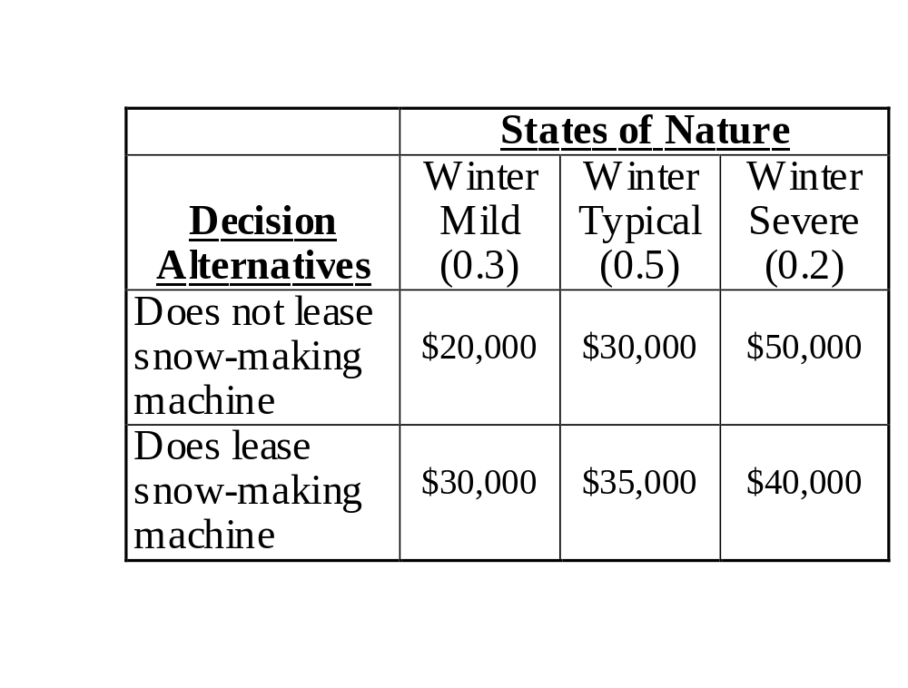
The Payoff Table: Problem 19.38
© 2011 Cengage Learning.
All Rights Reserved. May not be scanned, copied, or duplicated, or posted to a publicly accessible website, in whole or in part.

Slide 9
The Decision Tree
Decision Alternatives State of Nature Payoff
p₁ State 1 Occurs v₁₁
p₂ State 2 Occurs v₁₂
p₃ State 3 Occurs v₁₃
Select Alternative 1
p₁ State 1 Occurs v₂₁
p₂ State 2 Occurs v₂₂
p₃ State 3 Occurs v₂₃
Select Alternative 2
p₁ State 1 Occurs v₃₁
p₂ State 2 Occurs v₃₂
p₃ State 3 Occurs v₃₃
Select Alternative 3
© 2011 Cengage Learning.
All Rights Reserved. May not be scanned, copied, or duplicated, or posted to a publicly accessible website, in whole or in part.

Slide 10
The Decision Tree: Problem 19.38
Does not lease snow-
making machine
0.3 Winter mild $20,000
0.5 Winter typical $30,000
0.2 Winter severe $50,000
Does lease snow-
making machine
0.3 Winter mild $30,000
0.5 Winter typical $35,000
0.2 Winter severe $40,000
© 2011 Cengage Learning.
All Rights Reserved. May not be scanned, copied, or duplicated, or posted to a publicly accessible website, in whole or in part.

Slide 11
Non-Bayesian Decision Theory:
Strategies Without Probabilities
Maximin Strategy - Select the alternative with the least unfavorable possible outcome.
Maximax Strategy - Select the alternative with the best possible outcome.
Minimax Regret - Select the alternative that minimizes the regret the decision maker will experience after the state of nature is known.
© 2011 Cengage Learning.
All Rights Reserved. May not be scanned, copied, or duplicated, or posted to a publicly accessible website, in whole or in part.

Slide 12
Non-Bayesian Decision Theory:
Problem 19.38
Maximin Strategy:
  Decide to lease the snow-making machine because the minimum payoff for that alternative is $30,000, which beats the minimum payoff of $20,000 for the alternative to not lease the snow-making machine.
Maximax Strategy:
  Decide to not lease the snow-making machine because the maximum payoff for that alternative is $50,000, which beats the maximum payoff of $40,000 for the alternative to lease the snow-making machine.
© 2011 Cengage Learning.
All Rights Reserved. May not be scanned, copied, or duplicated, or posted to a publicly accessible website, in whole or in part.

Slide 13
Bayesian Decision Theory:
Strategies With Probabilities
Expected Payoff (or Expected Monetary Value) Criterion: Select the alternative where the expected value for the payoff is the best.
Expected Opportunity Loss Criterion: Select the decision alternative with the minimum expected regret value.
© 2011 Cengage Learning.
All Rights Reserved. May not be scanned, copied, or duplicated, or posted to a publicly accessible website, in whole or in part.

Slide 14
Expected Value: Problem 19.38
Does not lease snow-
making machine
0.3 Winter mild $20,000
0.5 Winter typical $30,000
0.2 Winter severe $50,000
0.3($20,000) + 0.5($30,000) + 0.2($50,000) = $31,000
Does lease snow-
making machine
0.3 Winter mild $30,000
0.5 Winter typical $35,000
0.2 Winter severe $40,000
0.3($30,000) + 0.5($35,000) + 0.2($40,000) = $34,500
© 2011 Cengage Learning.
All Rights Reserved. May not be scanned, copied, or duplicated, or posted to a publicly accessible website, in whole or in part.

Slide 15
Expected Value: Problem 19.38
In the long run, the operator will expect to earn $34,500 if he does lease the snow-making machine compared to $31,000 if he does not lease the snow-making machine.
Best Decision: Lease the snow-making machine.
© 2011 Cengage Learning.
All Rights Reserved. May not be scanned, copied, or duplicated, or posted to a publicly accessible website, in whole or in part.

Slide 16
The Expected Value of Perfect Information (EVPI)
EVPI = –
where the expected payoff value of perfect information is the product of the probability that state of nature j occurs times the best payoff of any alternative for state j.
The EVPI represents the maximum amount the decision maker should be willing to spend to reduce uncertainty about which state of nature will occur.
Expected payoff with
perfect information
Expected payoff with
present information
© 2011 Cengage Learning.
All Rights Reserved. May not be scanned, copied, or duplicated, or posted to a publicly accessible website, in whole or in part.

Slide 17
The Expected Value of Perfect Information: Problem 19.38
With perfect information, the operator will:
  Lease the machine in a mild winter, $30,000
  Lease the machine in a typical winter, $35,000
  Not lease the machine in a severe winter, $50,000
Perfect information will earn the operator:
  0.3($30,000) + 0.5($35,000) + 0.2($50,000) = $36,500
So the value of perfect information is:
$36,500 – $34,500 = $2,000
© 2011 Cengage Learning.
All Rights Reserved. May not be scanned, copied, or duplicated, or posted to a publicly accessible website, in whole or in part.

Slide 18
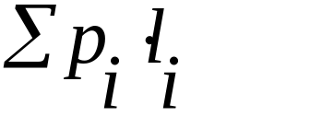
The Expected Opportunity Loss (EOL)
EOL is another term for regret and is calculated in a manner similar to expected payoff:
EOL =
where p_{i} is the probability that state of nature i will occur, and l_{i} is the opportunity loss if this alternative is selected and state of nature i occurs.
© 2011 Cengage Learning.
All Rights Reserved. May not be scanned, copied, or duplicated, or posted to a publicly accessible website, in whole or in part.

Slide 19
EOL: Problem 19.38
Does not lease snow-
making machine
0.3 Winter mild $30,000 – $20,000
0.5 Winter typical $35,000 – $30,000
0.2 Winter severe $0
0.3($10,000) + 0.5($5,000) + 0.2($0) = $5,500
Does lease snow-
making machine
0.3 Winter mild $0
0.5 Winter typical $0
0.2 Winter severe $50,000 – $40,000
0.3($0) + 0.5($0) + 0.2($10,000) = $2,000
© 2011 Cengage Learning.
All Rights Reserved. May not be scanned, copied, or duplicated, or posted to a publicly accessible website, in whole or in part.

Slide 20
EOL: Problem 19.38
In the long run, the operator will expect to have an opportunity loss of $5,500 if he does not lease the snow-making machine compared to $2,000 if he does lease the snow-making machine.
Best Decision: Lease the snow-making machine.
© 2011 Cengage Learning.
All Rights Reserved. May not be scanned, copied, or duplicated, or posted to a publicly accessible website, in whole or in part.

Slide 21
Incremental Analysis for Inventory Decisions
When the numbers of decision alternatives and states of nature are extremely large, the payoff table and related decision tree may be too cumbersome to use in decision making. In such applications, we can use incremental analysis.
Applied to inventory decisions, inventory units
  are sequentially considered;
  are stocked only if marginal profit exceeds marginal loss.
© 2011 Cengage Learning.
All Rights Reserved. May not be scanned, copied, or duplicated, or posted to a publicly accessible website, in whole or in part.

